Slide 1


Improving Health Care Quality: Living Independently with Geriatric Resources and Care of Elders (GRACE)
NUR NUR 930: DNP Project & Nursing Scholarship 3
Karlee Litchfield & Kari Bernhardt
October 23, 2022

Slide 2
Summary of Intervention
The GRACE model was developed by a geriatrician to help primary care providers overcome the limitations of delivering care to older patients in outpatient settings
This model expands upon the Patient Centered Medical Home (PCMH), which is a collaborative primary care model designed to improve care coordination and patient access, with in-home visitation by a care team
Primary goal: Optimize the health and functional status of patients living at home while reducing their need for hospital care
(McCarthy et al., 2021; Ritchie et al., 2016)

Slide 3
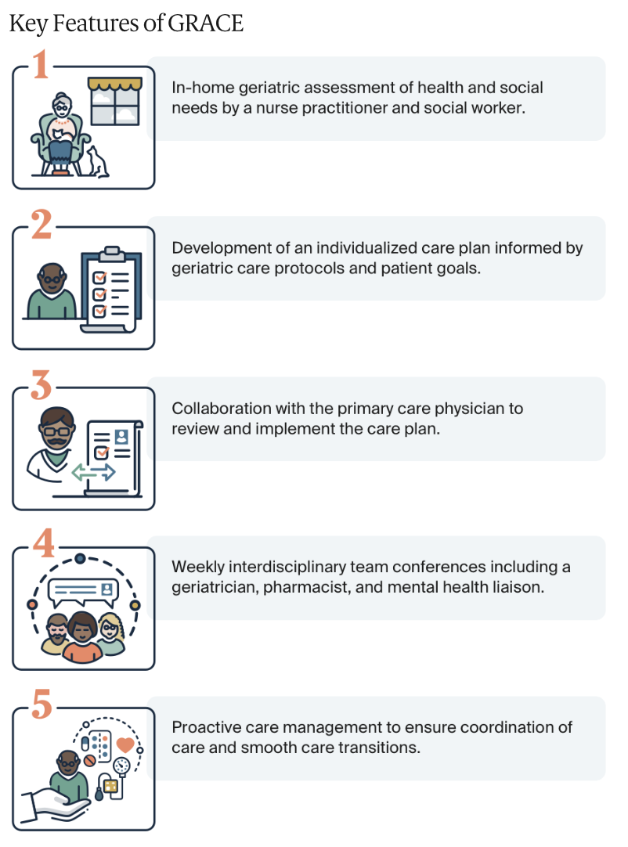
Key Features of the
GRACE Model
(McCarthy et al., 2021)

Slide 4
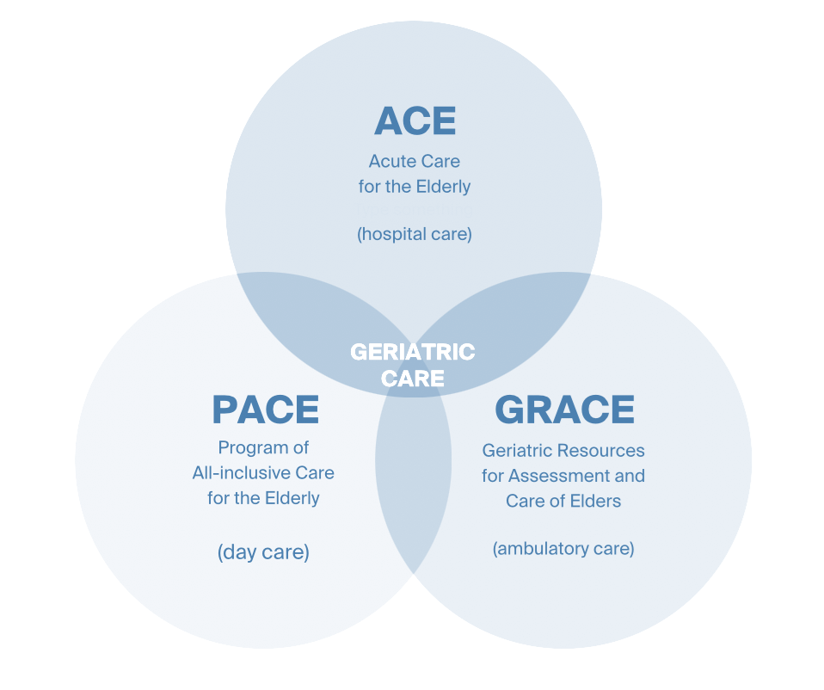
Setting
The GRACE model focuses on ambulatory care and was inspired by other pre-existing geriatric care models
(McCarthy et al., 2021)
Notes:
The GRACE model focuses on ambulatory care, which allows patients to maintain a relationship and continuity of care with their PCP
This model was inspired by other pre-existing geriatric care models that focus on delivery in hospitals and day-care settings

Slide 5
Population Served by the Intervention of the Project
Patients 65+ with complex health and social needs who need additional care management and support to continue living independently in their home
  Patients with multiple chronic conditions who may have functional limitations that require the support of a caregiver
  Specifically addresses the geriatric needs of older patients with dementia and depression who may not be well served by routine care management programs
(McCarthy et al., 2021; Ritchie et al., 2016)

Slide 6
Study Design
Randomized-controlled trial
254 patients 65+ with complex needs enrolled in GRACE sponsored by Indiana University Health Medicare Advantage Plan
    Served by community health centers affiliated with Eskenazi Health , an urban public safety-net health system
(McCarthy et al., 2021; Counsell et al., 2006)
Notes:
Original study- 2007
Research assistants screened patients with scheduled appointments at the targeted primary care practices to deter- mine eligibility. Patients were eligible for enrollment if they were aged 65 and older, had an annual household income below 200% of the federal poverty level (e.g., o$25,000 for family unit of two persons), had one or more primary care visits in the past 12 months, resided in the community, and had access to a telephone. Excluded from the study were patients unable to understand English and those who had severe hearing impairment, were on dialysis or enrolled in another research study, or had severe cognitive impairment without an available caregiver to consent to participate. The Indiana University institutional review board approved the study, and participants provided written in- formed consent.

Slide 7
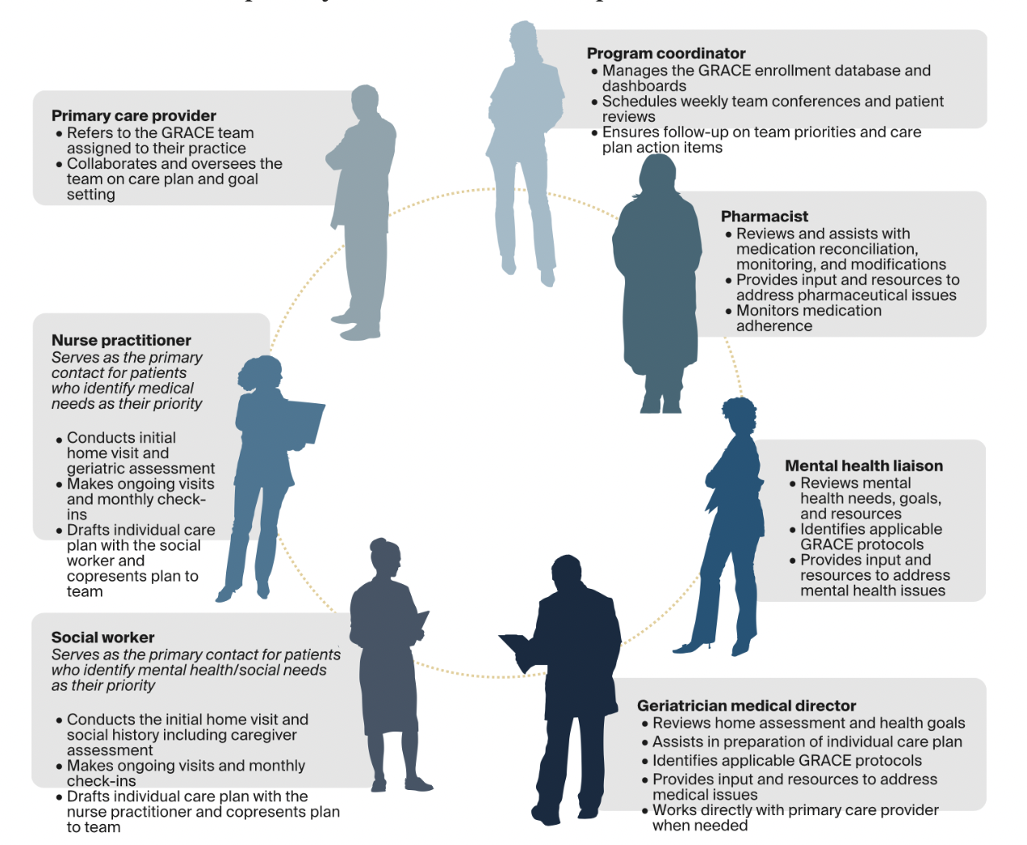
Support & Facilitators
(McCarthy et al., 2021)
Notes:
Support and facilitators of the intervention or project
Nurse Practitioner
prescribed medications and managed medical care to relieve PCPs of the extra workload
Clinical social worker
managed client's mental health and social issues including guardianship, adult protective services, food security programs, and support at home
Mental Health liaison
helped support the social worker in complex clients with untreated mental health issues

Slide 8

Implementation Costs
The cost of the intervention was $1,000 per patient per year
  - Patient recruitment
  - Training of NPs, social workers, support staff, PCPs
  - 10% of the total cost was covered under Medicare reimbursements
(McCarthy et al., 2021; Counsell et al., 2006)
Notes:
Salary and benefits for personnel, mileage reimbursement, cell phone costs, home visit bags, office supplies, and cost of direct care.

Slide 9
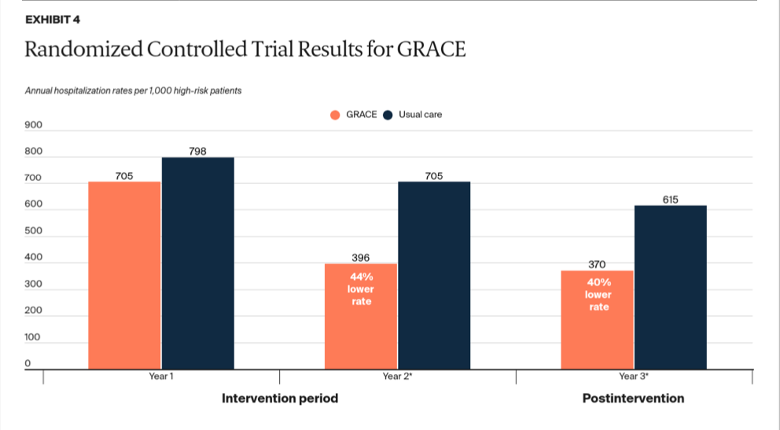
Study Results
(McCarthy et al., 2021)
Notes:
In 2007, Indiana University School of Medicine completed a randomized controlled trial to assess the effects of the GRACE model among low-income patients ages 65 and over
Patients at higher risk of hospitalization achieved the best results, with a 35 percent lower rate of ED visits and a 44 percent lower rate of hospital admissions by the second year (Exhibit 4).
GRACE participants also received improved quality of care and reported enhanced quality of life — including general health, vitality, social functioning, and mental health — compared with patients in the control group.
A cost analysis found that, among high-risk patients, savings from reduced hospital utilization paid for the cost of the intervention during the two years of the trial. In the third (postintervention) year, savings of $1,487 per high-risk patient were realized from a sustained lower rate of hospital utilization, compared with a control group (Exhibit 4).

Slide 10
Challenges
The model is most applicable to value-based financing arrangements and teams with expertise in geriatrics, pharmacy, and mental health
Cost savings can take time to accrue when enrolling patients from primary care but may be more immediate when enrolling patients at hospital discharge to reduce readmissions
Complex care plans can be difficult to complete in programs with shorter enrollment periods.
Notes:
No specific challenges or problems were reported during planning or implementation. However, after the study was complete, the authors noted that this model is most applicable to value-based financing arrangements and teams with expertise in geriatrics, pharmacy, and mental health. Additionally, they found that the cost savings from using the GRACE model may take time to accrue when enrolling patients from primary care, but may be more immediate when enrolling patients at hospital discharge to reduce readmissions. Finally, they found that complex care plans can be difficult to complete in programs with shorter enrollment periods.

Slide 11
Project Recommendations
GRACE model has been adopted in a variety of settings
  Tracking of programs that adopt an approach like the GRACE model will generate knowledge on how to adapt their design and implementation to meet the needs of specific setting
    i.e. home visits vs. phone visits vs. physician's office
Health Plans may find it advantageous to develop common objectives for care management programs that engage PCPs participating in multiple plans, or to create and participate in multiplayer initiatives
  providers can apply consistent approaches to managing their high-risk patient populations
(McCarthy et al., 2021)

Slide 12

GRACE care model enhances geriatric care management
Home-based primary care program that is flexible and can be replicated/adopted in a diversity of settings
Conclusion
Represents a promising new model for PCP and the care of geriatric patients with complex health needs
  Improves care coordination and patient outcomes
  Improves outcomes of geriatric patients with complex health & social needs
  Yields long-term cost savings for the health care system
  Helps PCPs overcome limitations of delivering care to geriatric patient in an outpatient setting
  Indiana University School of Medicine offers technical assistant for model adopters
(McCarthy et al., 2021)

Slide 13
References
Counsell, S. R., Callahan, C. M., Buttar, A. B., Clark, D. O., & Frank, K. I. (2006). Geriatric Resources for Assessment and Care of Elders (GRACE): A New Model of Primary Care for Low-Income Seniors. Journal of the American Geriatrics Society, 54(7), 1136–1141.doi:10.1111/j.1532-5415.2006.00791.x
McCarthy, D., Waugh, L., & Nong, P. (2021). Living independently with GRACE: The geriatric resources for assessment and care of elders model. The Commonwealth Fund. https://www.commonwealthfund.org/publications/case-study/2021/oct/living-independently-grace
Ritchie, C., Andersen, R., Eng, J., Garrigues, S., Intinarelli, G., Kao, H., Kawahara, S., Patel, K., Sapiro, L., Thibault, L., Tunick, E., & Barnes, D. (2016). Implementation of an interdisciplinary, team based complex care support health care model at an academic medical center: Impact on health care utilization and quality of life. PLos One, 11(2), e0148096. doi: 10.1371/journal.pone.0148096

